Slide 1
Happiness Score Analysis Country wise!
Wide analysis on Happiness Score From years 2015-2021 including each world country’ data.
Finding the main Features impacting the most on happiness score.
COVID-19 effect on world’s happiness.

Slide 2
Happiness Score Shows Many Features…
The main features of a country and region which make their people happy or sad…everybody wants to know.
These may include many among political, economical and natural environment of a country.
Everyone wants to know how the COVID-19 pandemic has affected their people around the world.
And along with the continuous change in other features where in the future our country seems to be in the range of happiness of it’s people.

Slide 3
The DATA Acquisition and Cleaning
The Happiness report for years from 2015 to 2021 has been taken from Kaggle dataset.
The latitude and longitude data for each country has been taken using geocoders to make map of happiness rank of countries according to average happiness score in 7 years.
Then the 7 years’ data is merged containing main 6 features and overall 10 columns.
The data frame contains 1084 rows and 10 columns in total.

Slide 4
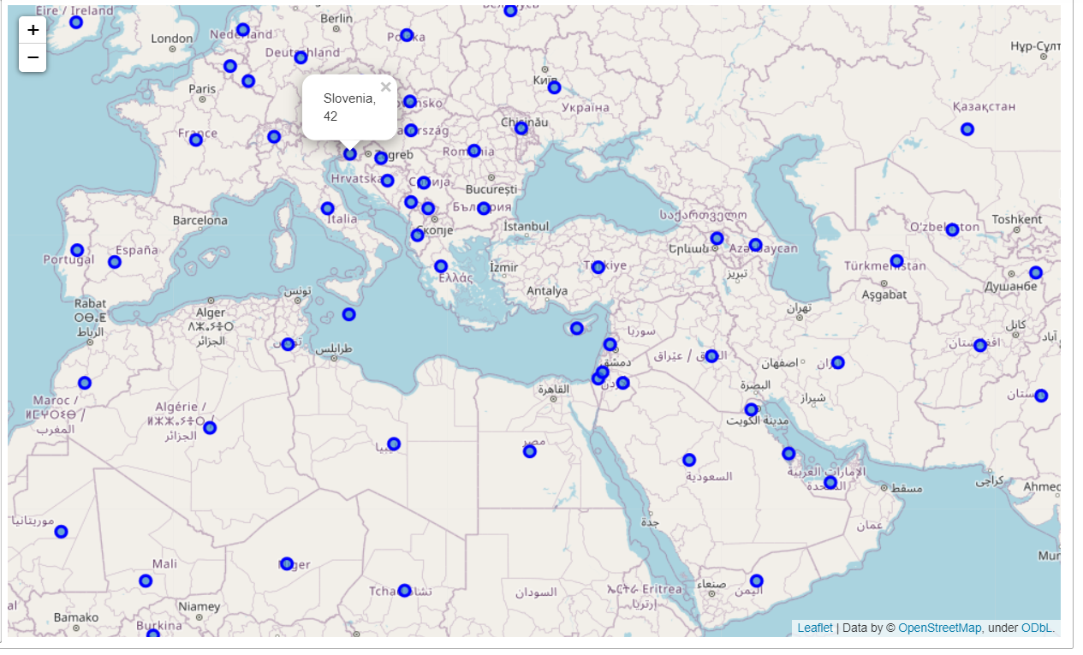
The Happiness Rank On World Map

Slide 5
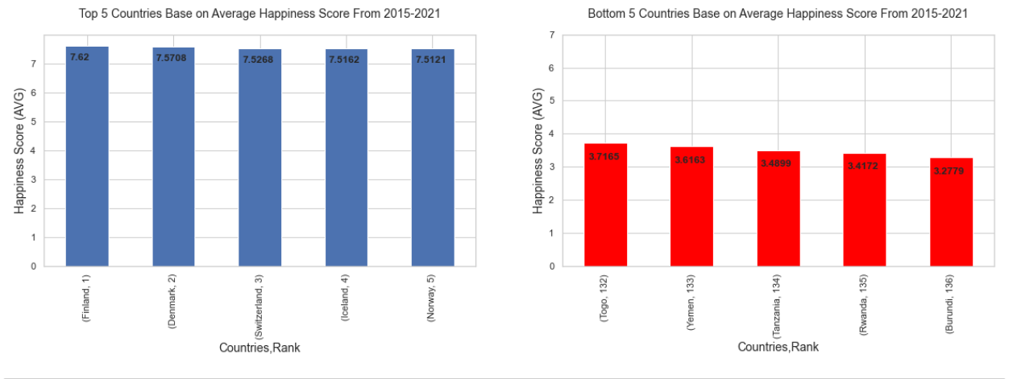
Top VS Bottom 5 Countries Based on Average Happiness Score From 2015-21

Slide 6
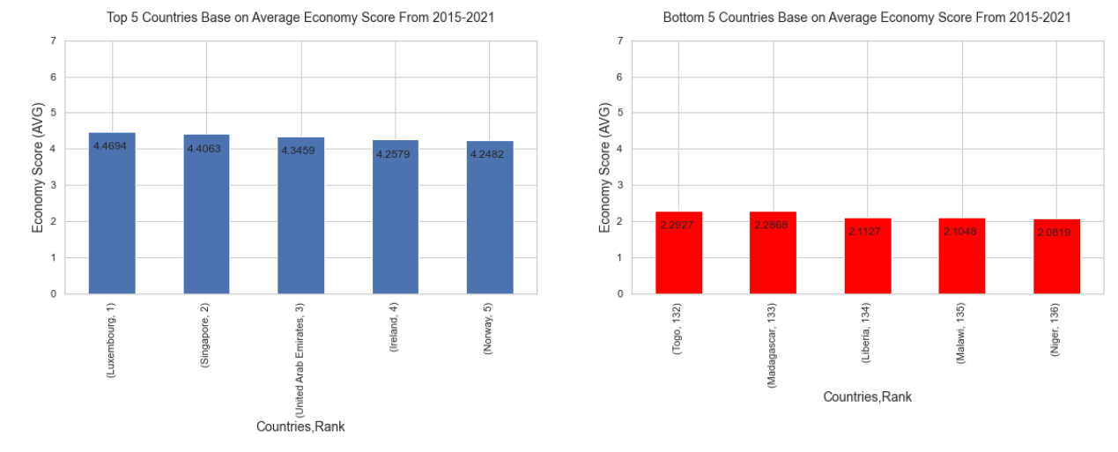
Top VS Bottom 5 Countries Based on Average Economy Score From 2015-21

Slide 7
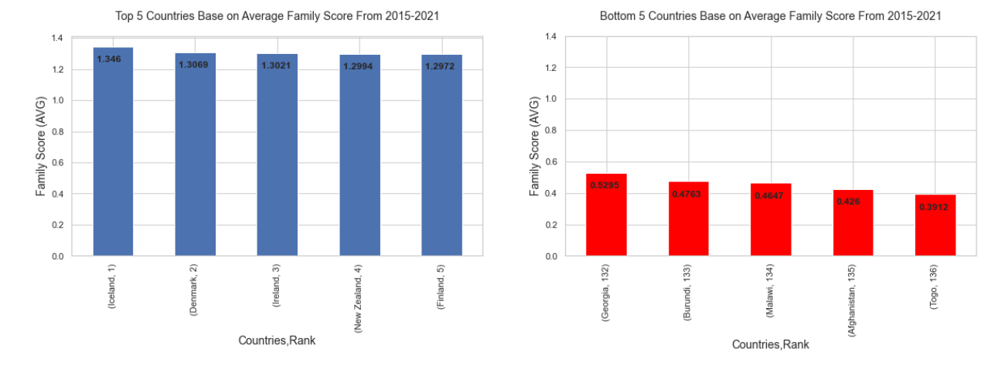
Top VS Bottom 5 Countries Based on Average Family/Social Support Score From 2015-21

Slide 8
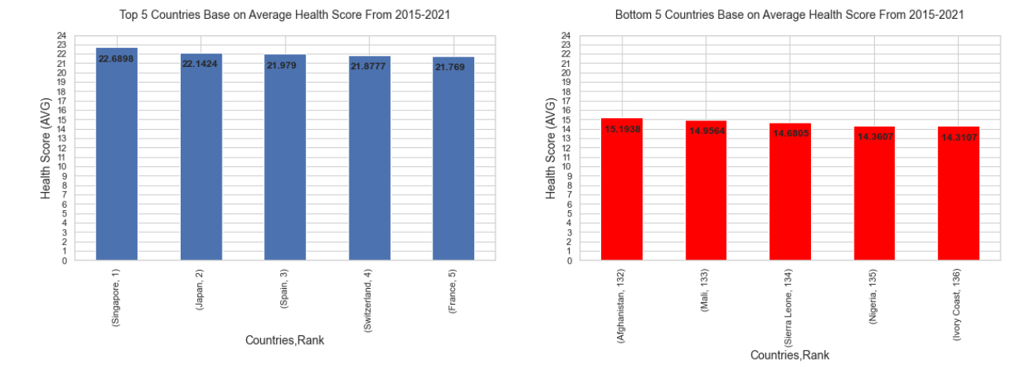
Top VS Bottom 5 Countries Based on Health Score From 2015-21

Slide 9
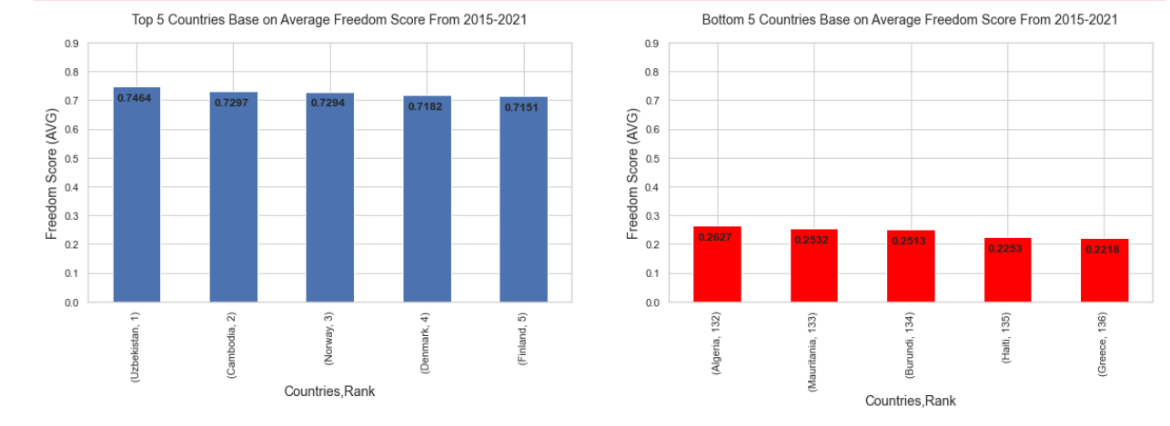
Top VS Bottom 5 Countries Based on Average Freedom Score From 2015-21

Slide 10
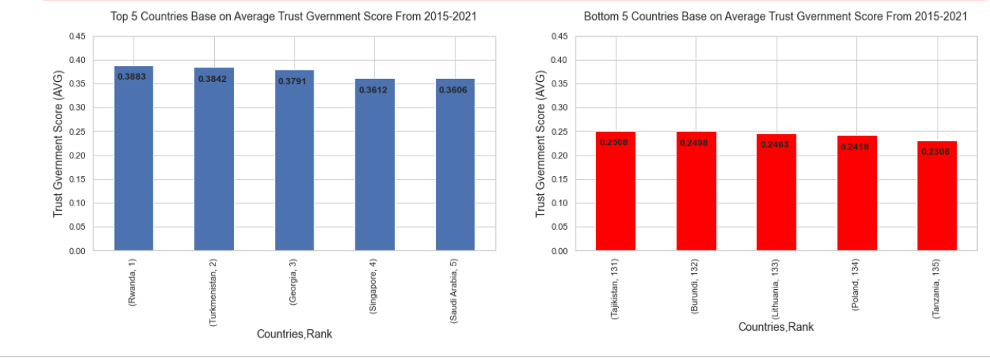
Top VS Bottom 5 Countries Based on Average Trust (Government Corruption Perception) From 2015-21

Slide 11
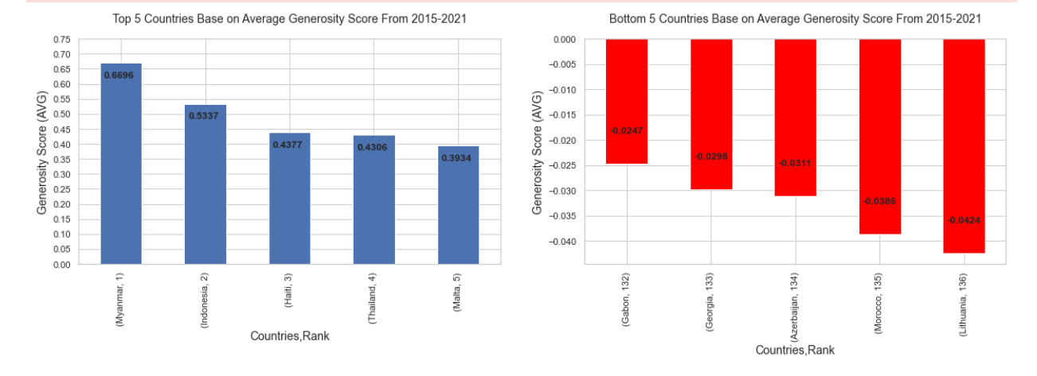
Top VS Bottom 5 Countries Based on Generosity Score From 2015-21

Slide 12
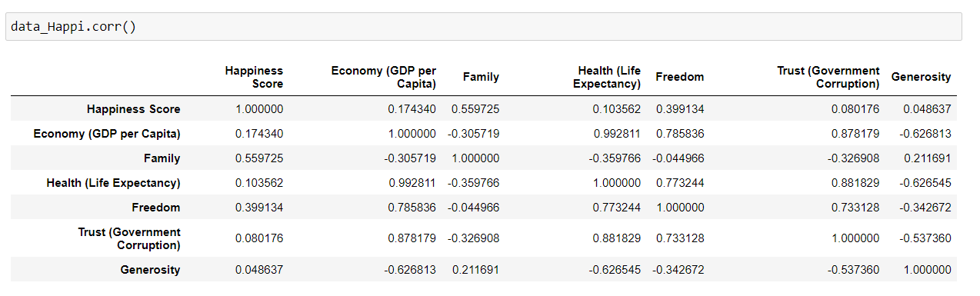
Correlation between features and finding which feature is more effective on Happiness score.
The most effective feature is family/social support for people’ happiness .
Then freedom of making life choices most affect their mood.

Slide 13
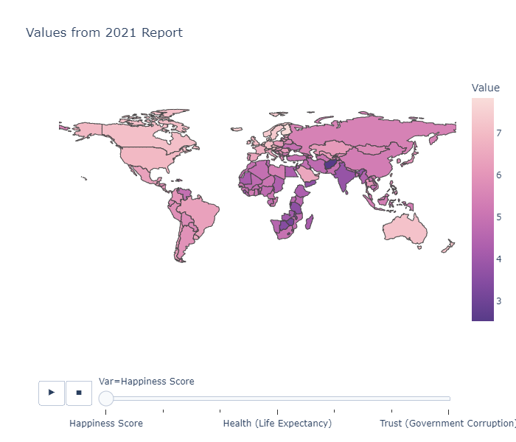
Effect of COVID-19 on World’s Happiness
The animation shows the different values of feature like-
happiness score,
health score,
family score,
economy score,
freedom score,
generosity score,
Trust score
for every country included in dataset.

Slide 14
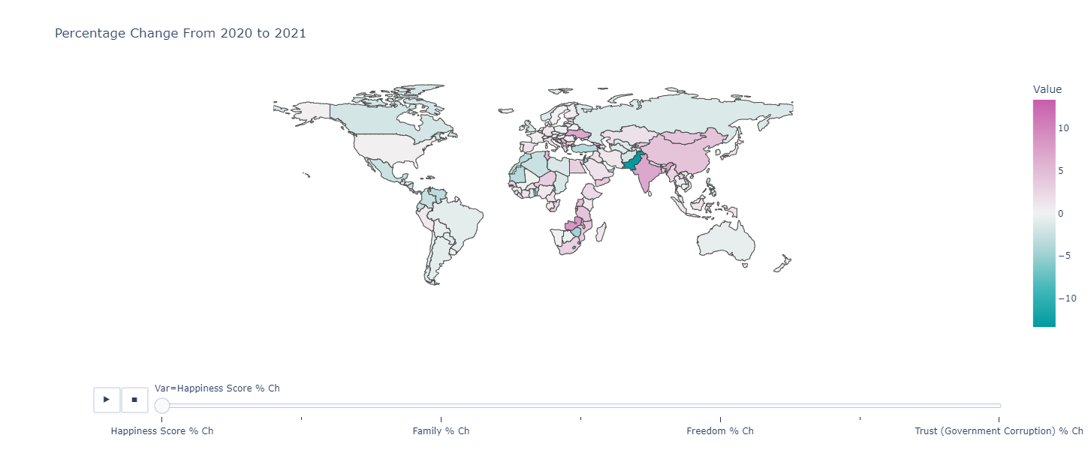
Percentage Change in value of features from 2020 to 2021
The animation shows the percentage change in the value of features from 2020 to 2021.
And thus shows the effect of COVID-19 on every feature on every country.

Slide 15
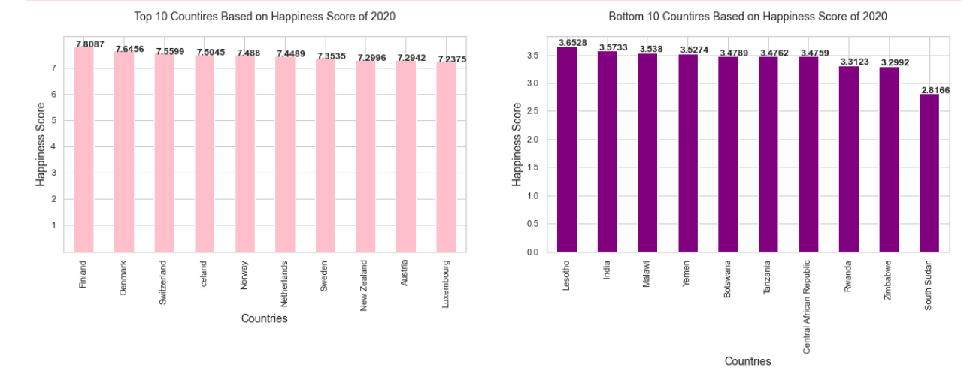
Top and Bottom 10 countries based on Happiness score in 2020

Slide 16
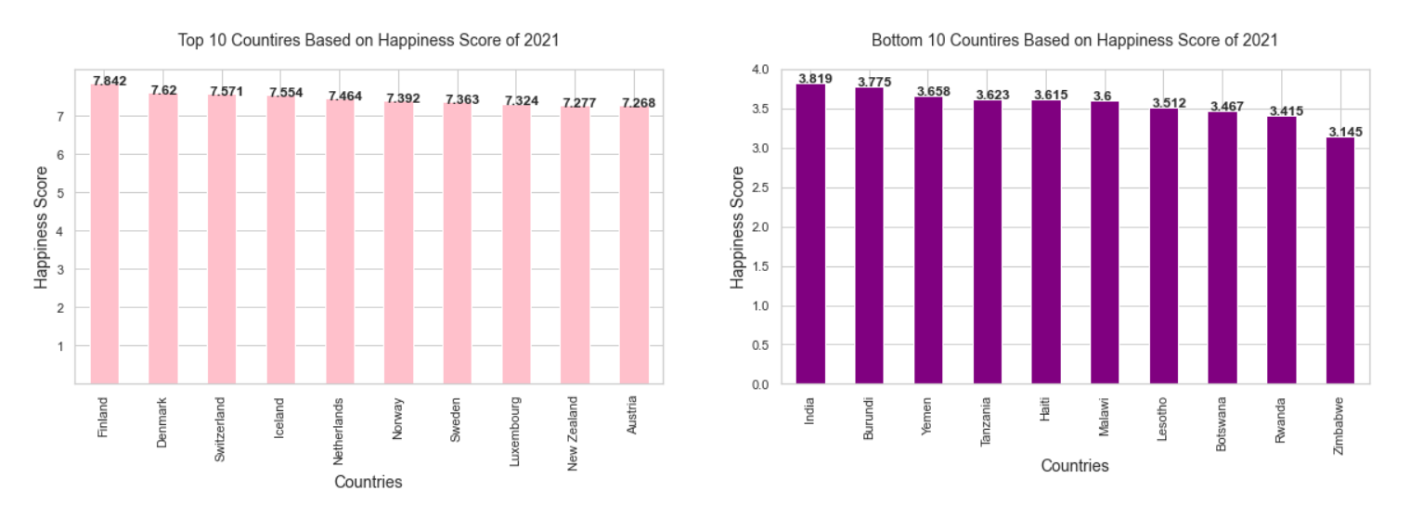
Top and Bottom 10 Countries Based on Happiness Score in 2021

Slide 17
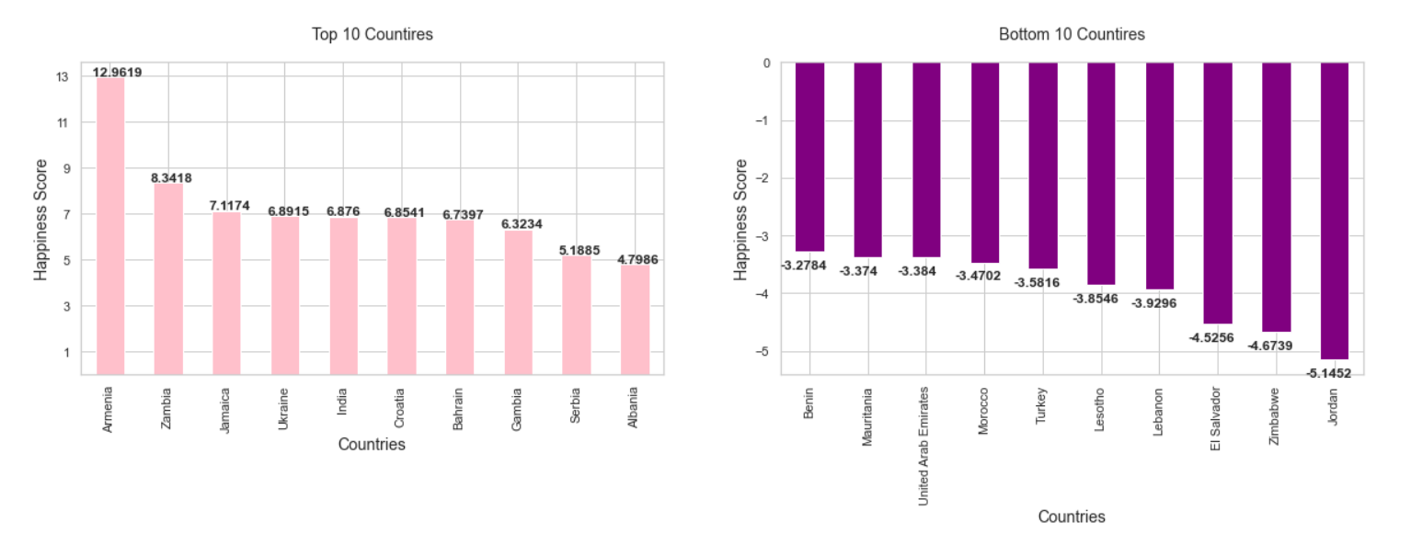
Top and Bottom 10 Countries Based on Percentage change in Happiness Score from 2020 to 2021

Slide 18
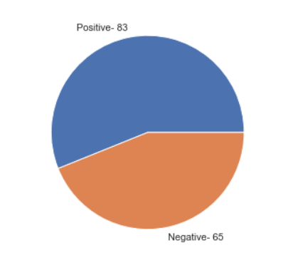
Positive and Negative Effect of COVID-19 on Happiness
The Figure shows that 83 countries responded positively with respect to happiness score during pandemic while 65 countries shown negative reaction.
Which means more countries/ people felt happy due to the positive aspects of pandemic.

Slide 19
Conclusion of Research Report
The Happiness Score not only the people’s moments of happiness, I think it shows lot more than that including different aspects like how generous the country’s people are, how well is country doing in economic sector, how safe, free and supportive the people feel there, how much their own people trust their government, how healthy there people are.
The all features overall equally affects the people’s happiness but the main factor is family and social support of people to each other.
The COVID-19 crisis affected the countries’ happiness score almost equally in both ways positively and negatively and people’s positive thinking and hope for future is definitely main factor for a country’s happiness score.

